Slide 1
A Time-dependent SIR model for COVID-19 with Undetectable Infected Persons
Advisor: Prof. Cheng-Shang Chang.
Presented by Yi-Cheng Chen, Jul. 3, 2020
Notes:
各位老師大家好，我是陳奕丞，今天要跟大家報告的論文題目是 A time-dependent SIR model for COVID-19 with undetectable infected persons.
是在張正尚老師的指導下完成的。

Slide 2
Outline
Introduction
The Time-dependent SIR model
The SIR model with undetectable infected persons
The IC model for disease propagation in networks
Numerical results
Discussions and suggestion
Conclusion
Notes:
Outline主要分成這幾個部分，還是按照introduction system model，然後實驗跟討論的部分

Slide 3
Outline
Introduction
The Time-dependent SIR model
The SIR model with undetectable infected persons
The IC model for disease propagation in networks
Numerical results
Discussions and suggestion
Conclusion

Slide 4
Introduction
At the beginning of December 2019 the first COVID-19 victim was diagnosed with the coronavirus in Wuhan.
  In the following weeks, the disease spread widely in China mainland and other countries, which causes global panic.
There are some strategies have been adopted by the governments of China and other countries in the world to block the spread of the virus.
  City-wide lockdown, social distancing, herd immunity
One problematic characteristic of COVID-19 is that there are asymptomatic infections.
  Only 87.9% of COVID-19 patients have a fever.
Notes:
1. 從去年12月底的第一起COVID-19感染者在武漢確診開始，接下來的幾個禮拜在中國快速傳播，接著蔓延到全世界的大遊行，至今已經超過1000萬人確診，大家應該都多少聽說過。
2. 各個國家都有一些對應的政策來試圖阻止病毒的傳播與擴散，像是封城、保持社交距離，甚至是群體免疫(Herd immunity)
3. 但有個特別的點是COVID-19存在無症狀感染者，根據WHO的研究指出，只有約90%的感染者有發燒的症狀，代表如果我們用量體溫當成偵測COVID-19的標準，有超過10%的人沒辦法被偵測出來。

Slide 5
Introduction
We are interested in addressing the following important questions for COVID-19.
  (Q1) Is it possible to contain COVID-19?
    Are the strategies effective in containing COVID-19?
  (Q2) If COVID-19 can be contained, when will be the peak of the epidemic, and when will it end?
We propose using a time-dependent susceptible-infected-recovered (SIR) model to analyze and predict the trend of the disease
Notes:
在這篇論文裡呢我們主要想討論6個問題，其中第一個是我們有沒有辦法控制COVID-19疫情的擴散，這些防疫政策是真的有效的嗎?我們能不能觀察到這個現象。接著如果疫情可以被控制的話，那疫情最高峰的時候會是什麼時候? 甚至什麼時候會結束?
針對這兩個問題我們提出一個time-dependent的SIR model來觀察與預測疾病發展的趨勢，觀察防疫政策的成效。

Slide 6
Introduction
  (Q3) How do the asymptomatic infections affect the spread of disease?
  (Q4) If COVID-19 cannot be contained, what is the ratio of the population that needs to be infected in order to achieve herd immunity?
We extend our SIR model to include two types of infected persons: detectable (type I) and undetectable (type II) infected persons.
Notes:
接著第三個問題是在前面有提到關於無症狀感染者的問題，我們好奇無症狀感染者會怎麼影響疫情的傳播?
除此之外，如果疫情無法被防疫政策控制，要使多少比例的人獲得抗體來達到群體免疫的效果?
針對這個問題我們延伸SIR model，考慮兩種感染者，分別是可被偵測的與不可被偵測的感染者，後者即無症狀感染者

Slide 7
Introduction
  (Q5) How effective are the social distancing approaches?
    Such as reduction of interpersonal contacts and canceling mass gatherings in controlling COVID-19?
We take the social network (and its network structure) into account and consider the independent cascade (IC) model for disease propagation in random network specified by a degree distribution.
Notes:
接著第五個問題是我們常聽到的防疫政策像是保持社交距離、禁止大型集會等，我們了解這些政策對於防疫的效果到底有多少？
對此我們將社群網路的網路架構加入討論，並使用independent cascade model來模擬疾病在random network中的傳播，而這個random network是按照特定的degree distribution建成，也就是configuration model。

Slide 8
Introduction
  (Q6) If COVID-19 cannot be contained, what is the ratio of the population infected in the long run?
We show that COVID-19 cannot be contained, then a certain proportion of the population will be infected.
Moreover, the ratio of the population infected in the long run can also be computed from a fixed point equation.
Notes:
1. 最後一個問題是，在剛剛那樣子的random network底下，如果COVID-19的疫情無法被控制，那會有多少比例的人受到感染？

Slide 9
Outline
Introduction
The Time-dependent SIR model
The SIR model with undetectable infected persons
The IC model for disease propagation in networks
Numerical results
Discussions and suggestion
Conclusion
Notes:
1. 接著就按照順序來介紹三個系統架構，首先是time-dependent SIR model

Slide 10
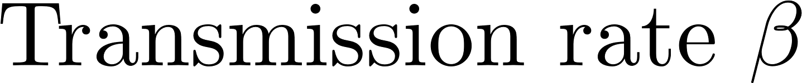
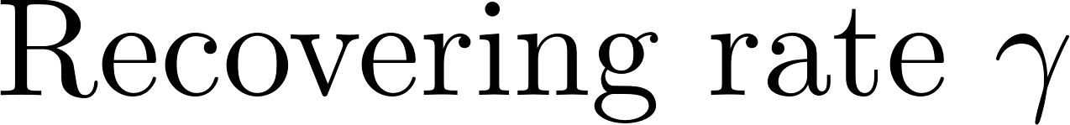
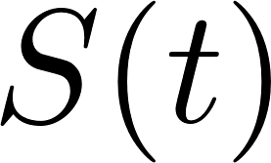
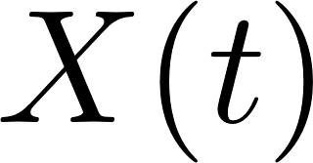
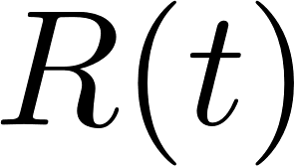
Susceptible-infected-recovered (SIR) Model
One of epidemic model, known as the susceptible-infected-recovered (SIR) model includes three states:
Susceptible
state
Infected
state
Recovered
state
Notes:
1. 這邊我很快的介紹一下傳統的SIR model，有三個State，分別是Susceptible、Infected和Recover，其中大SXR(t)分別代表在時間t時的人數，與兩個固定的參數，分別是Transmission rate (beta)與Recovering rate (gamma)，State的變化就像箭頭的方向一樣，假設一但從Infected State康復就不會再回到Susceptible state。
2. 其中要注意的是deaths和recovered從epidemic model的角度來看是一樣的，因為他們都不再具有傳染性。

Slide 11
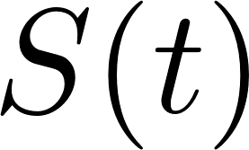
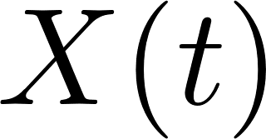
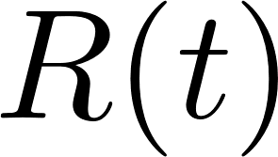
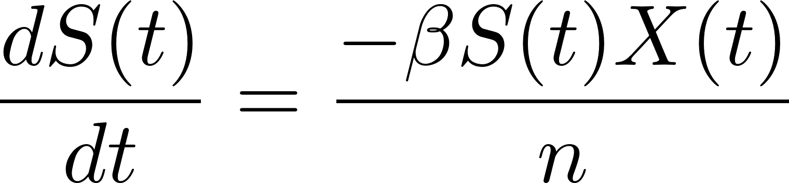
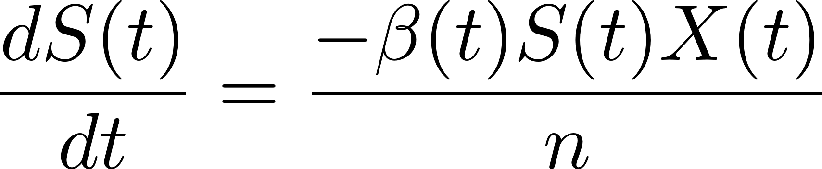
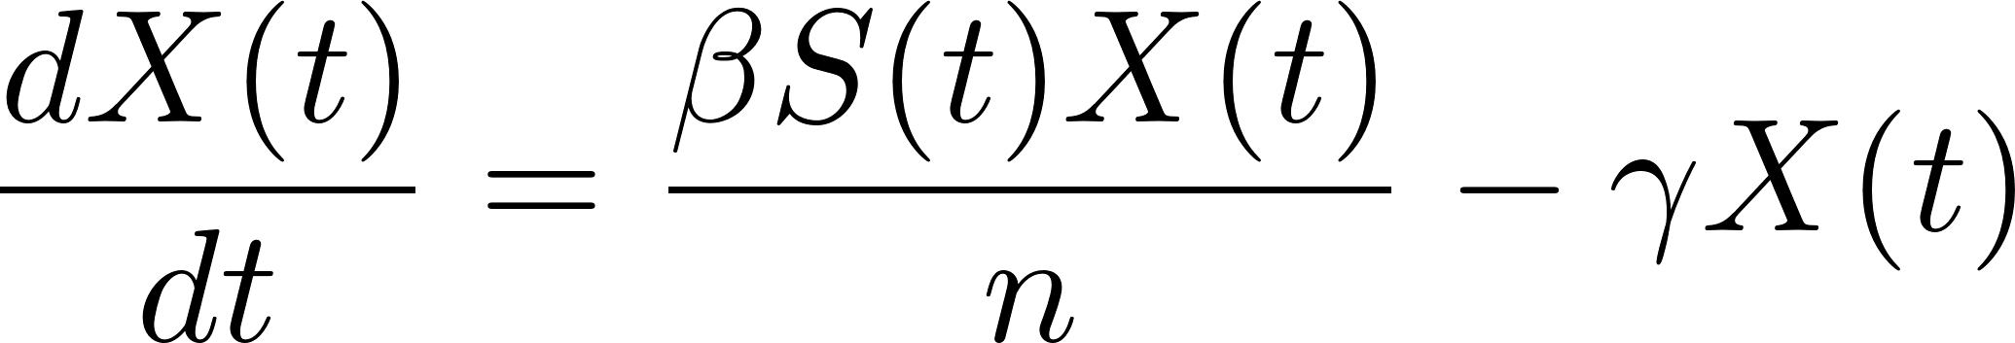
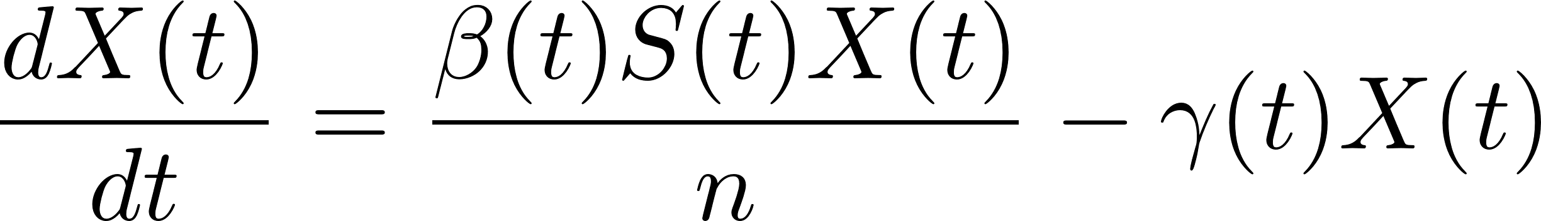
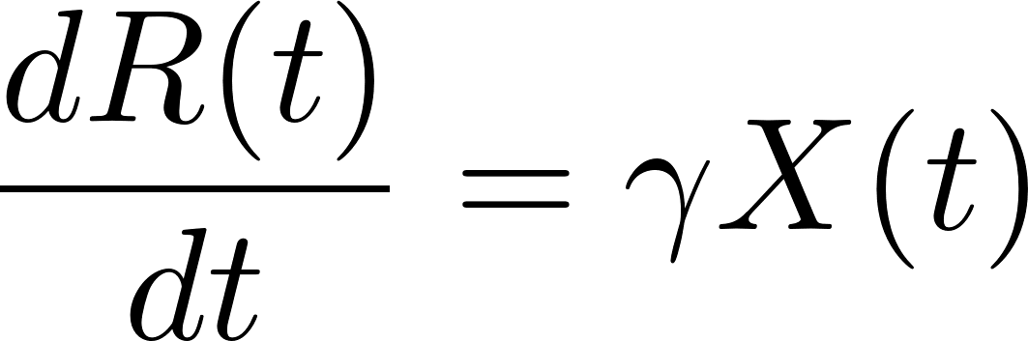
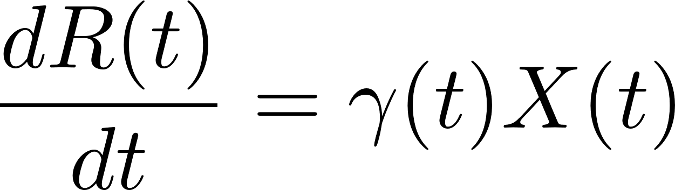
Differential Equations for the Time-dependent SIR
For the traditional SIR model, the three variables S(t), X(t) and R(t) are governed by the following differential equations:
Notes:
傳統SIR model 的differential equation如這三個式子所示，分別代表每個時間點人數的變化量，如果假設總人口數為n，在時間點t隨機挑一個人是在Susceptible的機率是S/n，那代表平均每個Infected會傳染給bS/n個人，再乘上X即為共有多少人在時間點t被感染，而同時Infected的人也會以gamma的速率復元，所以式子如這樣所示。
接著可以發現beta與gamma都是fixed的，所以接著我們把他改寫為時間t的函數，變成右邊這個樣子

Slide 12
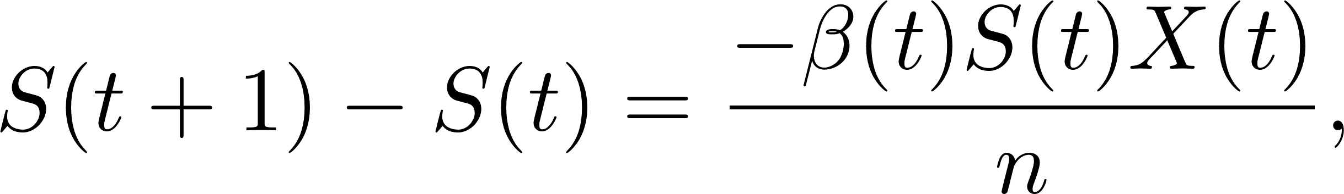
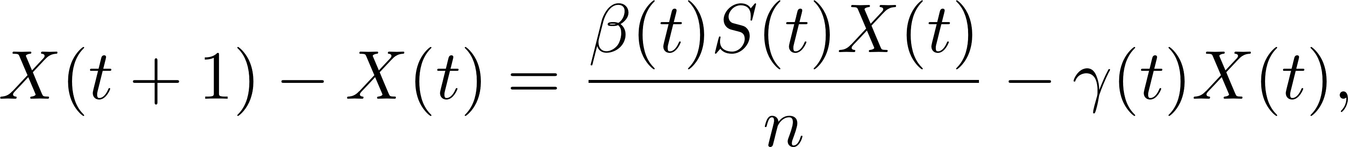
Discrete Time Time-dependent SIR Model
Due to the COVID-19 data is updated in days, we revise the differential equations into discrete time difference equations:
Notes:
1. 接著因為COVID-19的資料是以天為單位來進行更新，所以我們把剛剛的式子改寫成離散的形式。

Slide 13
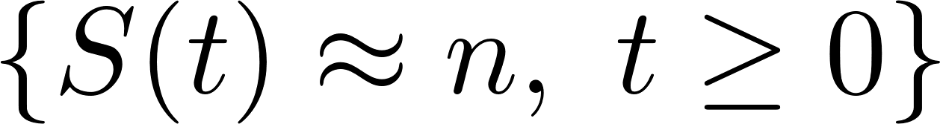
Discrete Time Time-dependent SIR Model
In the beginning of the disease spread, the number of confirmed cases is very low, and most of the population are in the susceptible state. Hence, for our analysis of the initial stage of COVID-19, we assume fS(t) n; t 0g , and further simplify as follows:
Notes:
1. 接著是假設的部分，因為在疾病傳染的初期確診人數非常低，且幾乎所有的人口都有可能被感染，所以我們假設任何時間點t的Susectible的人數都趨近於n，這樣剛剛的三條式子就可以化減成這兩條，其中S(t)與n就消掉了。

Slide 14
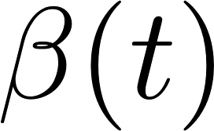
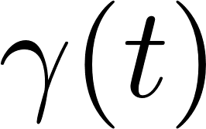
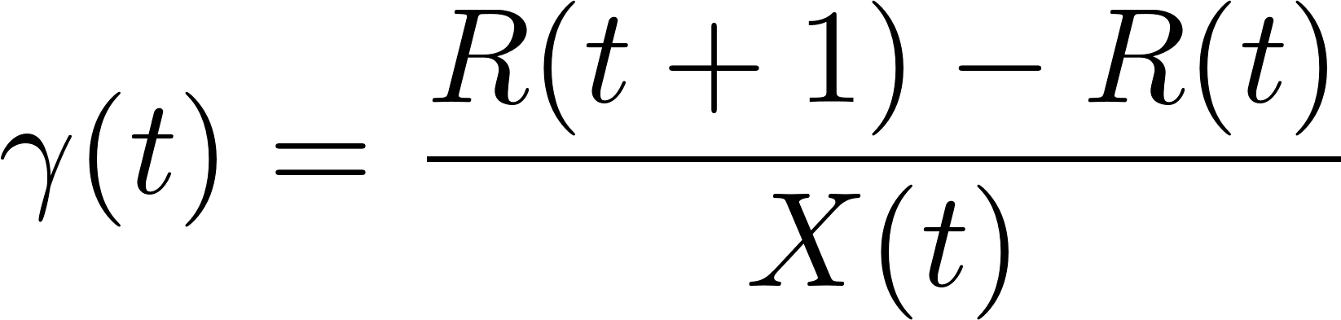
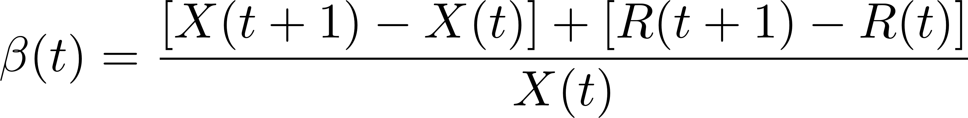
Discrete Time Time-dependent SIR Model
From the difference equations above, one can easily derive B(t) and r(t) .
Given the historical data from a certain period
We can measure the corresponding
Notes:
接著透過簡單的移項我們可以推導出gamma與beta在時間t時對應的值。
所以我們只要給定歷史的疫情資料，便可以計算對應的beta與gamma

Slide 15
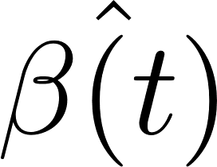
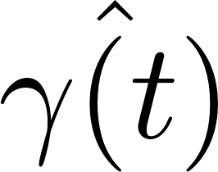
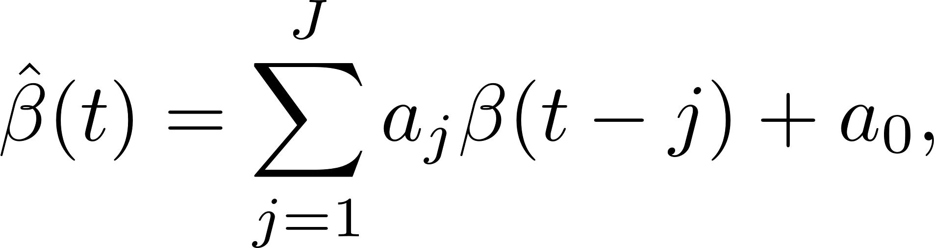
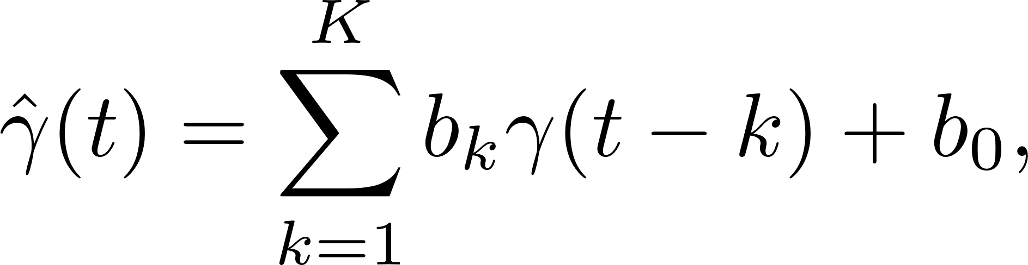


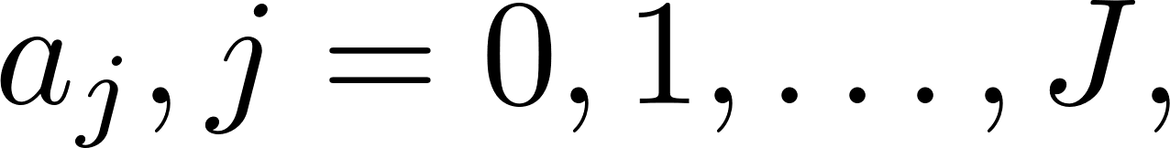
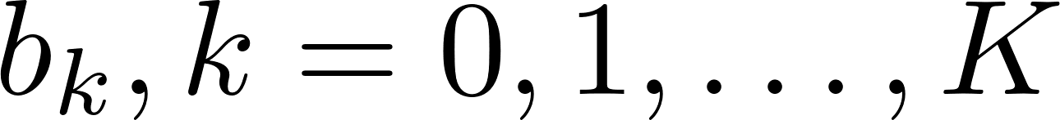
Tracking Transmission Rate and Recovering Rate by Ridge Regression
We track and predict (t) and (t) by the commonly used Finite Impulse Response (FIR) filters in linear systems.
  Denote by ^ (t) and ^(t) the predicted transmission rate and recovering rate.
  where J and K are the orders of the two FIR filters (0< J, K < T-2), and are the coefficients of the impulse responses of these two FIR filters.
Notes:
接著我們利用常見的FIR filter來追蹤beta與gamma隨著時間的變化，用這個hat來代表預測的值。
我們可以把beta hat與gamma寫成下面這樣的形式，其中JK代表FIR filter的order，而a與b代表對應的impulse response

Slide 16
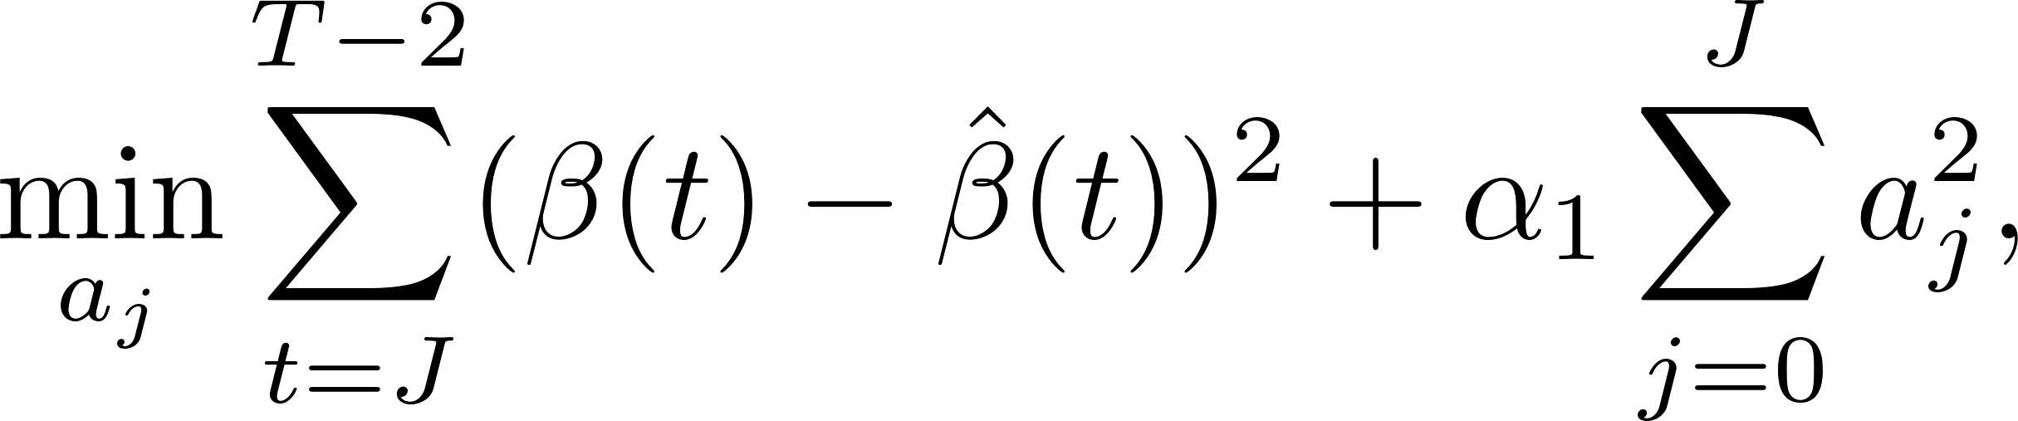
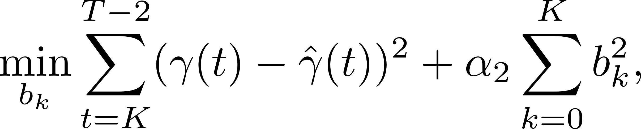


Tracking Transmission Rate and Recovering Rate by Ridge Regression
We choose the ridge regression as our estimation method that solves the following optimization problem:
  where and are the regularization parameters.
Notes:
1. 接著我們使用Ridge Regression來解下面的optimization problem，其中alpha 1和2是regularization parameter，而透過解這兩個式子我們就可以找到FIR filter的各個impulse response，也就是後面這個a和b

Slide 17
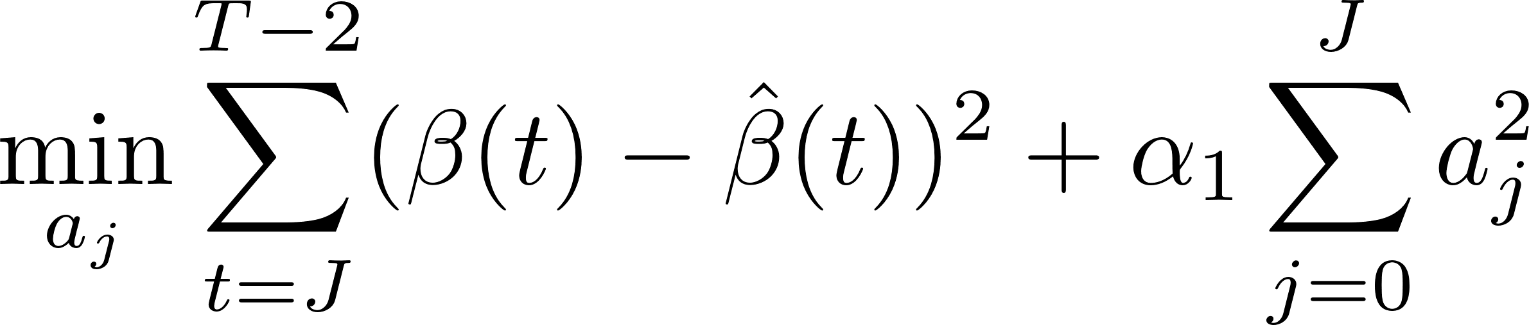
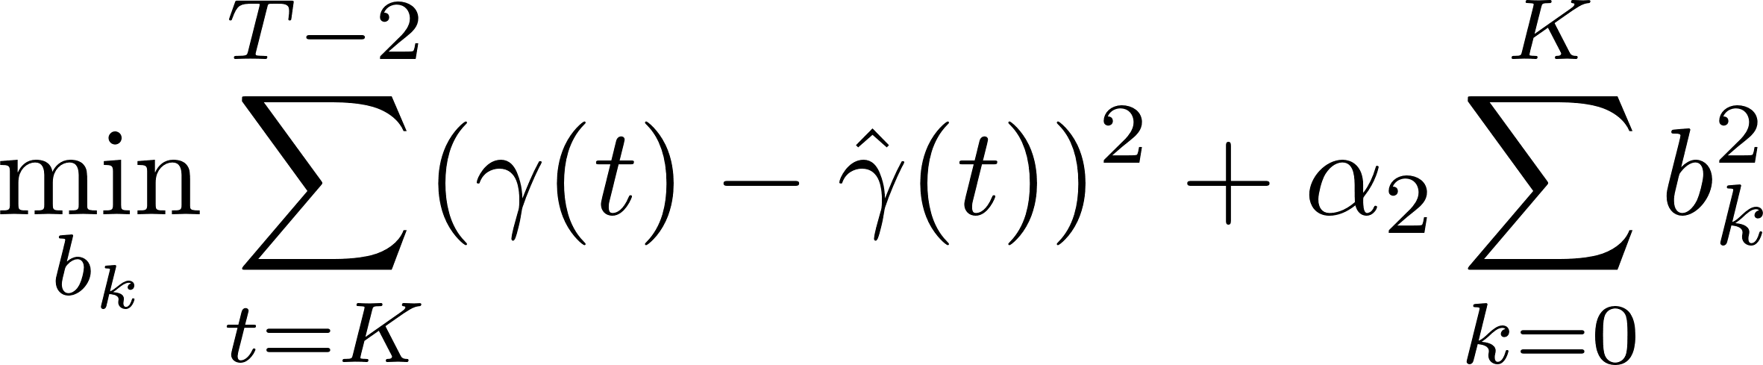
Tracking the Number of Infected Persons and the Number of Recovered Persons
1. Given the historical data from a certain period
2. We first measure
3. Then we solve the ridge regression with the objective functions to learn the coefficients of the FIR filters
Notes:
到這邊為止就是我們的time-dependent SIR model，接著我們就可以來預測疾病發展的趨勢，這邊統整一下流程。
首先給定歷史的資料X與R，計算對應時間點的beta與gamma。
透過解Ridge regression的方式來求FIR filter的參數

Slide 18
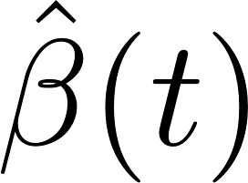
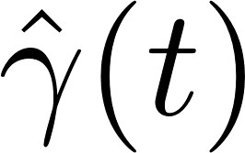
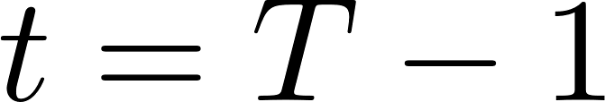
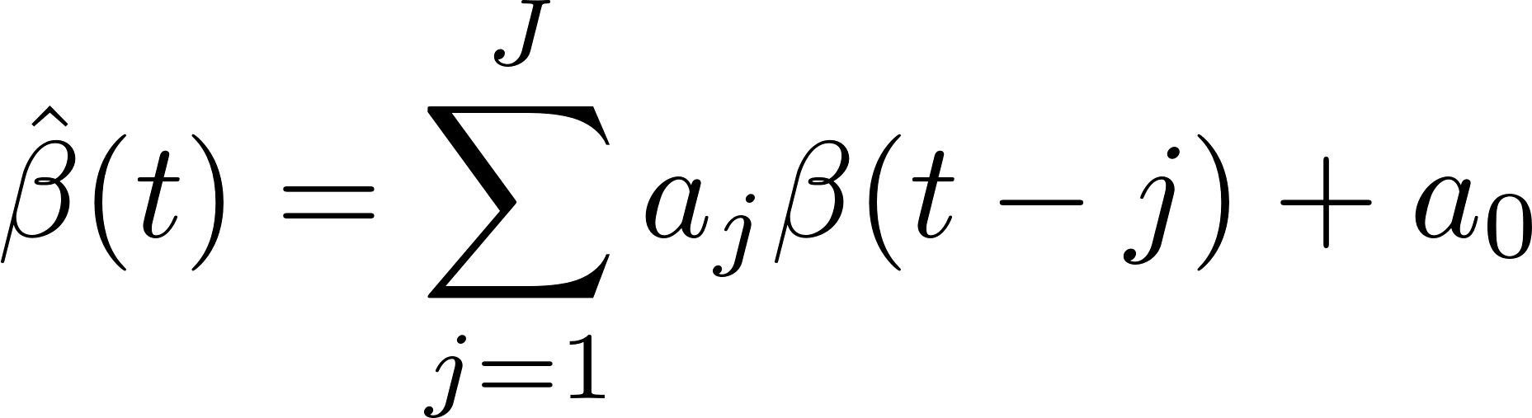
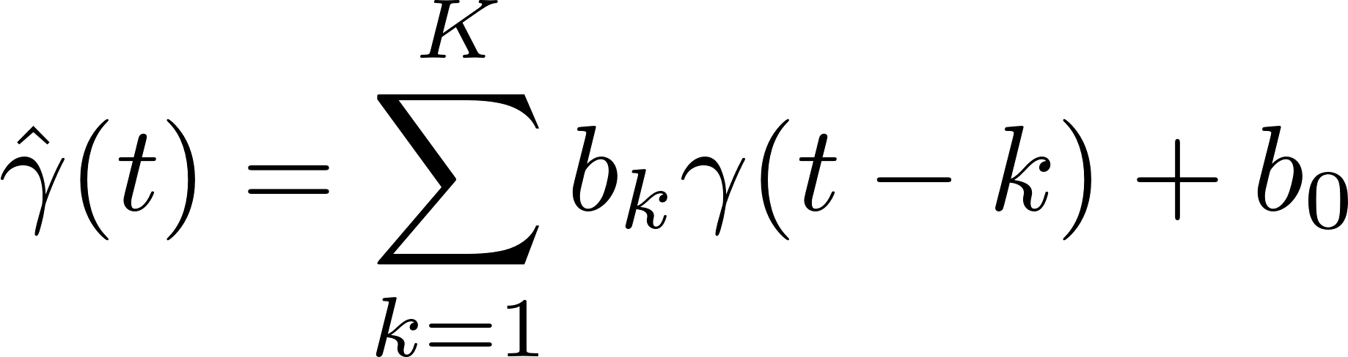
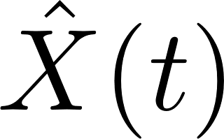
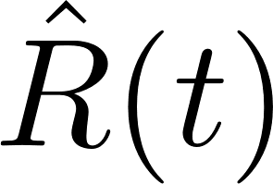
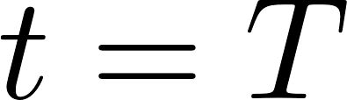
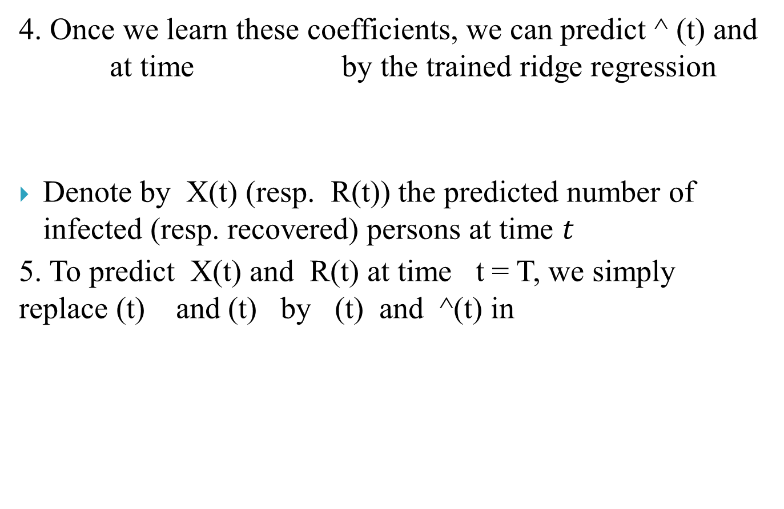
Tracking the Number of Infected Persons and the Number of Recovered Persons
4. Once we learn these coefficients, we can predict ^ (t) and at time by the trained ridge regression
Denote by X(t) (resp. R(t)) the predicted number of infected (resp. recovered) persons at time $t$
5. To predict X(t) and R(t) at time t = T, we simply replace (t) and (t) by (t) and ^(t) in
Notes:
求得這些參數以後就可以透過下面的式子來計算時間T-1時的beta與gamma。
同樣我們用這個加了hat的XR代表預測值，那我們把最一開始的差分方程移項一下，把預測的beta與gamma代進去，就可以計算下一個時間點的X與R

Slide 19
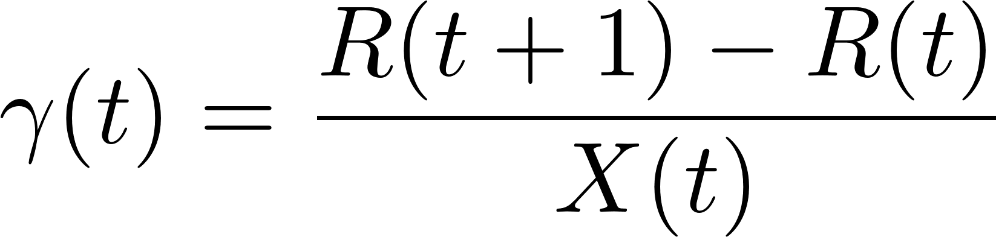
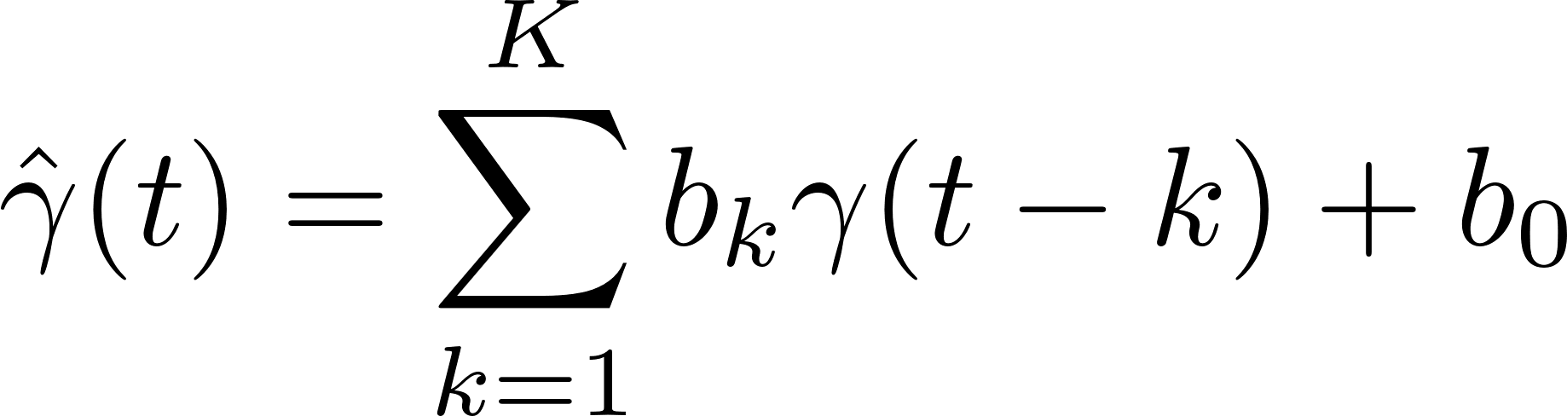
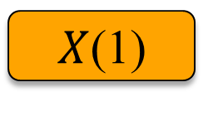
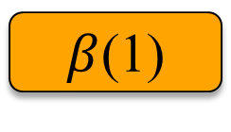
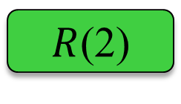
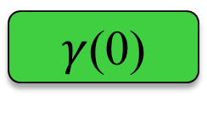
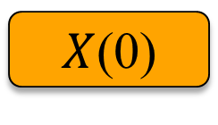
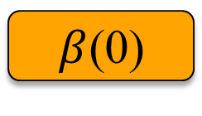
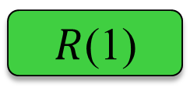
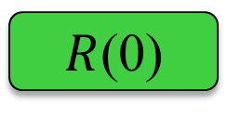










Tracking the Number of Infected Persons and the Number of Recovered Persons
$X$(0)
$X$(1)
$X$(2)
$$……$$
$X$(T-1)
$β$(0)
$β$(1)
$$……$$
$β$(T-2)
Ridge Regression
$R$(0)
$R$(1)
$R$(2)
$$……$$
$R$(T-1)
$γ$(0)
$γ$(1)
$$……$$
$γ$(T-2)
Ridge Regression

Slide 20














Tracking the Number of Infected Persons and the Number of Recovered Persons
FIR filter
$β$(T-3)
$β$(T-2)
$\hat{β}$(T-1)
$\hat{β}$(T)
$X$(T-1)
$\hat{X}$(T)
$\hat{X}$(T+1)
FIR filter
$γ$(T-3)
$γ$(T-2)
$\hat{γ}$(T-1)
$\hat{γ}$(T)
$R$(T-1)
$\hat{R}$(T)
$\hat{R}$(T+1)

Slide 21




The Basic Reproduction Number
The basic reproduction number R is one of the commonly used metrics to check whether the disease will become an outbreak
  : the number of additional infections by an infected person before it recovers
In the classical SIR model,
  13
In our time-dependent SIR model
  basic reproduction number is a function of time, and it is defined as .
Notes:
在接下去講之前先講一個很重要的概念就是Basic Reproduction Number，是一個很常見的指標來衡量傳染病會不會爆發，定義是一個感染者在康復前平均可以在額外傳染給幾個人
在傳統的SIR model下其實就是beta除以gamma，而在我們time-dependent SIR model下則為各個時間點的beta除以gamma

Slide 22



The Basic Reproduction Number
Therefore, by observing the change of with respect to time or even predict in the future, we can check whether certain epidemic control policies are effective or not.
If R0(t) > 1 , the disease will spread exponentially and infects a certain fraction of the total population $n$.
If , the disease will eventually be contained.
Notes:
1. 透過觀察R0隨著時間t的變化，我們就可以觀察防疫政策是否有效的反應在傳染率上。
2. 如果R0>1，代表疾病的傳播會以exponentially成長，最終導致一定比例的總人口受到感染，相反的如果R0<1，感染人數會逐漸下降最終結束疫情。

Slide 23
Outline
Introduction
The Time-dependent SIR model
The SIR model with undetectable infected persons
The IC model for disease propagation in networks
Numerical results
Discussions and suggestion
Conclusion

Slide 24



The SIR model with undetectable infected persons
To take the undetectable infected persons into account, we assume that there are two types of infected persons.
  The individuals who are detectable (with obvious symptoms) are categorized as type I infected persons
  The asymptomatic individuals who are undetectable are categorized as type II infected persons.
For an infected individual, it has probability to be type I and probability to be type II
  where .
Notes:
Besides, those two types of infected persons have different transmission rates and recovering rates,

Slide 25







The Governing Equations
Denote 1(t) and 1(t) as the transmission rate and the recovering rate of type I at time $t$.
  Similarly, 2(t) and for type II at time $t$.
Let X1(t) (resp. ) be the number of type I (resp. type II) infected persons at time $t$
Similar to the derivation of
We assume that and split into two types of infected persons.

Slide 26

The Governing Equations
We have the following difference equations:
  where are constants
It is noteworthy that those constants can also be time-dependent as we have in previous section
  However, in this section, we set them as constants to focus on the effect of undetectable infected persons.

Slide 27




The Governing Equations
Rewriting the governing equation in the matrix form yields the following matrix equation:
  where
Let be the transition matrix of the above system equations

Slide 28



The Governing Equations
It is well-known (from linear algebra) such a system is stable if the spectral radius (the largest absolute value of the eigenvalue) of is less than 1.
In other words, X1(t + 1) and X2(t + 1) will converge gradually to finite constants when $t$ goes to infinity.
  In that case, there will not be an outbreak.
On the contrary, if the spectral radius is greater than 1,
  There will be an outbreak.
  The number of infected persons will grow exponentially with respect to time $t$.

Slide 29



The Basic Reproduction Number
To further examine the stability condition of such a system, we let
Note that is simply the basic reproduction number of a newly infected person as an infected person can further infect on average (resp. ) persons if it is of type I (resp. type II) and that happens with probability (resp. ).
Notes:
R0其實就代表一個新被感染的人他可以額外感染幾個人

Slide 30


The Basic Reproduction Number
Notes:
如果這樣定義下的R0<1，則A的spectral radius會小於1，代表沒有outbreak (Perron-Frobenius throrem)

Slide 31
Herd Immunity
One interesting strategy, once suggested by Boris Johnson, the British prime minister, is to have a sufficiently high fraction of individuals infected by COVID-19 and recovered from the disease to achieve herd immunity.
The question is, what will be the fraction of individuals that need to be infected to achieve herd immunity for COVID-19.
We note that herd immunity corresponds to the reduction of the number of susceptible persons in the SIR model.
Notes:
英國首相Johnson曾經提過一個有趣的防疫政策，就是使的一定比例的人感染後復原來達到群體免疫。
問題是，一定比例指的是多少，我們發現其實群體免疫就等校於減少susceptible persons。

Slide 32


Herd Immunity
We assume that there is a probability $h$ that a randomly chosen person is susceptible at time $t$.
  This is equivalent to that $1−h$ fraction of individuals are immune to the disease.
Under such an assumption, we then have
In view of the difference equation
  We can rewrite the governing equations for herd immunity
Notes:
H代表我們任挑一個人他是Susceptible的機率，換句話說1-h代表挑到的這個人他已經免疫了

Slide 33
Herd Immunity
In comparison with the original governing equations
  The only difference is the change of the transmission rate.

Slide 34


Herd Immunity
Notes:
如果Eq. 25的R0>1，代表大流行會發生，如果要透過Herd immunity的方式來防止，則要讓Eq. 25<1，所以只要讓h star = 1/R0，就可以阻止大流行

Slide 35
Outline
Introduction
The Time-dependent SIR model
The SIR model with undetectable infected persons
The IC model for disease propagation in networks
Numerical results
Discussions and suggestion
Conclusion

Slide 36

The IC model for disease propagation in networks
Our analysis in the previous model does not consider how the structure of a social network affects the propagation of a disease.
  we consider the independent cascade (IC) model for disease propagation.
In the IC model, there is a social network modeled by a graph $G = (V, E)$,
  where $V$ is the set of nodes, and $E$ is the set of edges.
An infected node can transmit the disease to a neighboring susceptible node (through an edge) with a certain propagation probability
Notes:
在我們剛剛說的model中都沒有考慮社群網路的架構，即人跟人之間的互動關係，因此我們使用IC model來模擬傳染病的傳播。
在IC model中，我們考慮一個graph G = (V,E)，那一個感染的node可以透過一定的傳播機率經由他的edge傳染給他的neighbor。

Slide 37



The IC model for disease propagation in networks
As there are two types of infected persons in our model,
  we denote by 1 (resp. 2) the propagation probability that a type I (resp. type II) infected node transmits the disease to an (immediate) neighbor of the infected node.
  It becomes a type I (type II) infected node with probability (resp. )
Continuing the propagation, we thus form a subgraph of $G$ that contains the set of infected nodes in the long run. Call such a subgraph the infected subgraph.
Notes:
如果傳染病透過這樣子的方式傳播，過了一段時間後這些infected node會形成一個Subgraph of G，我們叫這個infected subgraph

Slide 38
The IC model for disease propagation in networks
One interesting question is how one controls the spread of the disease so that the total number of nodes in the infected subgraph remains small even when the total number of nodes is very large.
Notes:
我們在意的點是說，要怎麼控制疫情才有辦法使的total number of node n很大的時候，這個infected subgraph可以維持很小

Slide 39


The Infected Tree in the Configuration Model
The exact network structure is in general very difficult to obtain for a large population.
  However, it might be possible to learn some characteristics of the network, in particular, the degree distribution of the nodes.
The configuration model is one family of random networks that are specified by degree distributions of nodes.
  A randomly selected node in such a random network has degree $k$ with probability .
Notes:
要拿到整個網路架構，例如Adj可能很困難，相對容易的是我們去量測這個網路的架構，特別是Degree distribution。
因此我們選怎configuration model作為我們的random work，其中Configuration model是透過給定特定的Degree sequence 來建成

Slide 40

The Infected Tree in the Configuration Model
The edges of a node are randomly connected to the edges of the other nodes.
  As the edge connections are random, the infected subgraph appears to be a tree (with high probability) if one follows an edge of an infected node to propagate the disease to the other nodes in such a network.
Another crucial property of the configuration model is the excess degree distribution:
Notes:
各個node的edge彼此連接是隨機的，因此如果疾病的傳播是從一個node沿著edge一直傳下去的話，有很高的機率會形成Tree
其中excess degree distribution通常都和degree distribution不同，只有在degree distribution是poisson的時候才會相同，在這種情況下configuration model 會變成ER model

Slide 41




The Infected Tree in the Configuration Model
We are interested to know whether the size of the infected tree is finite.
  We say that there is no outbreak if the size of the infected tree of an infected node is finite with probability 1.
Let (resp. ) be the probability that the size of the infected tree of a type I (resp. type II) node is finite via a specific one of its neighbors.
X
Notes:
我們想了解這個infected tree的size是不是有限的，代表不會隨著n變大而變大。
因此我們說如果infected tree的size是finite的機率是1，代表沒有outbreak產生。
設u1代表挑到一個type 1 node從他的一個neighbors看出去的subgraph是finite的機率。
從一個infected node走出去的size如果是finite，代表不是giant component，所以u就代表從一個node走出去走不到giant component的機率，如果是1代表沒有大流行發生
1-phi代表這個node沒有被感染
phi代表被感染了，那這個點有w1和w2的機率為type1或type2，但只要這個點的k個鄰居也都連不到giant component，這個infected tree就還是finite的

Slide 42


The Infected Tree in the Configuration Model
Let the moment generating function of the excess degree distribution

Slide 43





The Infected Tree in the Configuration Model
we can solve and by starting from and
It is easy to show (by induction) that +1) 1 u(m)1 and u(m+1)2 u(m) . Thus, they converge to some fixed point solution and .
Notes:
我們可以透過疊代的方式來解u1,u2，因為u1,u2會逐漸遞增，所以最終會收斂在一個fixed point equation

Slide 44


Connections to the Previous SIR Model
Suppose that one end of a randomly selected edge is a type I node.
  Then this type I node will infect persons on average from the SIR model.
Since the average excess degree is ,
  the average number of neighbors infected by this type I node is .
Notes:
接著我們要將之前討論的SIR model與IC model連結起來，首先回到SIR model。
假設我們今天隨機挑了一個type 1 node，那在SIR model中，他平均可以傳染給R0個人。
接著回到IC model，其中呢mean excess degree可以透過這樣的方式算出，那平均一個type 1 node能額外傳染給幾個鄰居呢?
就是propagation probability乘上他平均有幾個excess neighbor

Slide 45


Connections to the Previous SIR Model
In order for a type I node to infect the same average number of nodes in the SIR model, we have
Similarly for , we have

Slide 46



Connections to the Previous SIR Model
With the propagation probabilities and ,
We have the following stability result.

Slide 47
Connections to the Previous SIR Model
Notes:
在這樣的R0條件下，我們可以證明u1和u2只有[1,1]的唯一解，代表只要R0小於1，選到一個被感染的node無論是type 1或type 2，不會有giant component的機率都是1，代表沒有大流行發生

Slide 48

Social Distancing
Social distancing is an effective way to slow down the spread of a contagious disease.
  One common approach of social distancing is to allow every person to keep its interpersonal contacts up to (on average) a fraction $a$ of its normal contacts
  In our IC model, this corresponds to that every node randomly disconnects one of its edges with probability $1−a$.
Notes:
那接著我們就來討論一下social distancing這種防疫政策的效用。
一種最常見的翻成白話文就是人跟人之間避免非必要的接觸嘛，用數學來講就是我們只留下 a 比例的normal contacts。
換句話說，在我們的ic model裡，每個node 會用1-a的機率來切斷他的edge

Slide 49
Social Distancing
As the same definition of and ,
Notes:
其實這個意思就是說，phi 原本代表的意思為沿著一條edge把疾病傳下去的機率，現在變成a^2 phi，因為edge要先被保留才有辦法傳下去

Slide 50



Social Distancing
We conclude that this approach of social distancing reduces the propagation probabilities 1 and 2 to a21 and a2 , respectively.
As a direct consequence of Theorem 3, we have the following corollary.
Notes:
因此和Herd immunity相同的概念，我們也是把propagation probability 降低一個比例，同樣的概念如果a^2 R0<1，則不會有outbreak產生

Slide 51

Social Distancing – canceling mass gathering
Another commonly used approach of social distancing is canceling mass gatherings.
  Such an approach aims to eliminate the effect of “superspreaders” who have lots of interpersonal contacts.
For this, we consider a disease control parameter 0 and remove nodes with the number of edges larger than or equal to k0 in our IC model.
Notes:
另一種社交距離的控制是禁止大型集會，禁止大型集會的目的就是要避免super spreader的出現。
對此我們設了一個control parameter k0，然後移除network 中所有degree>k0的node

Slide 52
Social Distancing – canceling mass gathering
We have
Notes:
被拿掉的人就代表他的u是1，因為無論如何都走不到giant component，那剩下的就同理

Slide 53

Social Distancing – canceling mass gathering
Analogous to the stability result of Theorem 3, we have the following stability result for a social distancing approach that cancels mass gatherings.
Notes:
接著也是相同的概念延伸出theorem 5，如果在我們考慮的model底下，將網路中degree>k0的node都拿掉，那R0會下降這個ratio，若這個值<1則我們可以保證size of the infected tree是finite的。

Slide 54


The Ratio of the Population Infected in the Long Run
If the disease cannot be contained, we ask the question of what is the ratio of the population infected in the long run.
In Theorem 3, we already showed that there is no outbreak if
In this subsection, we will show that if
  then a certain proportion of the population will be infected.

Slide 55

The Ratio of the Population Infected in the Long Run
Theorem 6.
  For the IC model (for disease propagation) in a random network constructed by the configuration model, suppose that the propagation probabilities and are specified in (44) and (45).
  Let
  be the moment generating function of the degree distribution and excess degree distribution

Slide 56


The Ratio of the Population Infected in the Long Run
Theorem 6. (cont.)
  If
  then there is a nonzero probability that a randomly selected node is infected in the long run (after the propagation of the disease in the IC model).
  The probability can be computed by the following equation:
  where
X

Slide 57


The Ratio of the Population Infected in the Long Run
Theorem 6. (cont.)
  and is the probability that one end node of a randomly selected edge is infected by one of its neighbors that is not on the other end of the selected edge.
  Moreover, the probability is the unique solution in a of the following fixed point equation:
Y
X

Slide 58



The Ratio of the Population Infected in the Long Run
Special Case:
  In particular, for the ER model, the degree distribution is the Poisson degree distribution with mean c, i.e.,
  The excess degree distribution of the Poisson degree distribution is the same as the degree distribution, i.e.,

Slide 59



The Ratio of the Population Infected in the Long Run
Special Case:
  In this case, we have and r is the unique solution in (0; 1] of the fixed point equation
  when

Slide 60
Outline
Introduction
The Time-dependent SIR model
The SIR model with undetectable infected persons
The IC model for disease propagation in networks
Numerical results
Discussions and suggestion
Conclusion

Slide 61
Numerical results
Dataset
Time Evolution of the Time-dependent SIR Model
One-day Prediction
Connections to the Wuhan City Lockdown
Basic Reproduction Numbers of Several Other Countries
The Effects of Type II Infected Persons
The Effects of Social Distancing
The ratio of the population infected in the long run

Slide 62
Dataset
For our analysis and prediction of COVID-19,
  We collect the number of confirmed cases, the number of recovered persons, and the number of deaths from Jan. 15, 2020 to Mar. 2, 2020 as our dataset
  Collect from NHC
The confirmed case is defined as the individual with positive real-time reverse transcription polymerase chain reaction (rRT-PCR) result.
  It is worth noting that in the Hubei province,
    the definition of the confirmed case has been relaxed to the clinical features since Feb. 12, 2020.
Notes:
我們主要使用中國的數據，是從National Health Commission蒐集的，其中要注意的是確診的定義為核酸檢測陽性，但湖北省在2/23的時候把確診定義放寬為臨床症狀，所以當日就新增非常多

Slide 63

Time Evolution of the Time-dependent SIR Model
Notes:
圓形是歷史資料
星星是預測
2/12斷點是確診定義改變

Slide 64

Time Evolution of the Time-dependent SIR Model
Notes:
提到封城時間，beta逐漸遞減
Gamma與beta黃金交叉代表疫情受到控制

Slide 65

Time Evolution of the Time-dependent SIR Model
Notes:
R0的預測，在三天前就觀察到R0<1的現象

Slide 66

One-day Prediction

Slide 67

One-day Prediction

Slide 68
Connections to the Wuhan City Lockdown

Slide 69

Connections to the Wuhan City Lockdown

Slide 70


Connections to the Wuhan City Lockdown

Slide 71

Basic Reproduction Numbers of Several Other Countries

Slide 72

The Effects of Type II Infected Persons
Notes:
這是一張Transition diagram，其中每個格子代表的是A這個矩陣的spectral radius，黑線代表的是Percolation threshold，也就是spectral radis=1的地方。
如果落在橘色的區域代表會有outbreak產生，反之黃色則沒有。
固定beta1和gamma1，並假設gamma2=gamma1，代表受到隔離與治療，在這樣的情況下type 2 的傳染率與被偵測出來的機率會如何影響疫情。
如果從w2的角度看，若能偵測出超過90%以上的感染者，即使beta2高達0.7仍能控制疫情。
同樣的若從beta2的角度看，降低beta2也能直接的抑制疫情的發展，而最簡單的方式就是透過戴口罩。

Slide 73

The Effects of Type II Infected Persons
Notes:
將w1設成發燒的比例87.9%，也是固定beta1與gamma1
接著我們挑了幾個國家來看，我們量測這些國家在疫情發展初期的beta與gamma來當作beta2與gamma2，因為我們認為在這個時間點還沒有防疫政策的介入，兩種感染者的行為模式是幾乎一樣的。
在這個實驗中我們固定w2，來看看type 2的感染者會怎麼影響疫情，從圖上可以看出，在橘色的點需要有立即的作為來控制疫情。

Slide 74
Dataset
Facebook Dataset: this dataset represents the verified Facebook page (with blue checkmark) networks of the artist category.
  Total number of node: 50,515
  Total number of edge: 819,306
  Mean degree: 32.4
  Mean excess degree:155.6

Slide 75

The Effects of Social Distancing

Slide 76


The Effects of Social Distancing
- canceling mass gathering
Notes:
這是關於Social distancing中禁止大型集會的實驗，我們從剛剛那個表格中挑出三個R0相對大中小的三個國家來測試。
圖中黑線代表facebook dataset的reduction ratio。
US k = 63, 影響13.1%的人
Italy k = 195, 影響2.2%的人
Korea k = 435, 影響0.4%的人

Slide 77

The ratio of the population infected in the long run
Notes:
Mean excess degree of BA = 84.04
Mean excess degree of Facebook = 155
因為我們設phi=R0/mean excess degree，因此越大的mean excess degree會導致越小的phi，使得最終的感染比例越小。
進一步解釋是在Power-law的network中，可能存在super spreader，可以一下子感染很多他的鄰居，可是他的鄰居的鄰居跟super spreader比起來很少，使得疾病很難傳的很遠
反觀ER model，因為是全部隨機連，可能不存在super spreader，在疾病的初期可能傳得很慢，可是因為他的infected subgraph是tree的形式，只要R0>1就能夠一直傳下去。

Slide 78
Outline
Introduction
The Time-dependent SIR model
The SIR model with undetectable infected persons
The IC model for disease propagation in networks
Numerical results
Discussions and suggestion
Conclusion

Slide 79


Discussions and suggestion
It seems that COVID-19 has been gradually controlled in China since the prevention policies,
  Such as city-wide lockdown, small community management
Although the policies can effectively reduce the transmission rates and .
  Restrict the right of personal freedom.
  Affect the normal operation of society.

Slide 80

Discussions and suggestion
Therefore, to strike a balance
  between the prevention of disease and ensuring the normal operation of society
  It is important to suggest the so-called “optimal” control policies.
From our results in Theorem 1, Corollary 2, Theorem 3, Corollary 4, and Theorem 5, we know that there is no outbreak for a disease if
Notes:
Theorem 1: R0<1 沒有outbreak , R0>1 有outbreak (SIR model)
Corollary 2: Herd immunity讓R0下降h倍
Theorem 3 : R0<1 沒有outbreak , R0>1 有outbreak (Network model)
Corollary 4: Social distancing讓R0下降a^2倍
Theorem 5:讓R0下降一個倍率(Cancelling mass gathering)

Slide 81



Discussions and suggestion
$h$ is the herd immunity reduction factor
$s$ is the social distancing reduction factor
(resp. ) is the probability that an infected person can (resp. cannot) be detected
and (resp. and ) are the transmission rate and the recovering rate of an infected person who can (resp. cannot) be detected.
Notes:
Theorem 1: R0<1 沒有outbreak , R0>1 有outbreak (SIR model)
Corollary 2: Herd immunity讓R0下降h倍
Theorem 3 : R0<1 沒有outbreak , R0>1 有outbreak (Network model)
Corollary 4: Social distancing讓R0下降a^2倍
Theorem 5:讓R0下降一個倍率(Cancelling mass gathering)

Slide 82


Discussions and suggestion
For COVID-19, and as an infected person, once detected, can be treated (to shorten the recovery time) and isolated (to reduce the transmission rate).
As , it is thus preferable to have a much larger than .

Slide 83

Discussions and suggestion
To prevent an outbreak, one should minimize the value on the left-hand side
Increasing the recovering rate
  find anti-virus drugs
Reducing the herd immunity reduction factor $h$
  find vaccines
Decreasing the transmission rate
  Isolation to avoid extra infection
  Quarantine of the suspected persons

Slide 84


Discussions and suggestion
Increasing the detection probability (decreasing )
  mass testing
  track the travel history, occupation, contact, and cluster (TOCC) of the confirmed cases
Decreasing the transmission rate
  wearing masks in public and enclosed space
Reducing the social distancing reduction factor $s$
  restrict the contact ( )
  canceling mass gatherings ( )

Slide 85
Outline
Introduction
The Time-dependent SIR model
The SIR model with undetectable infected persons
The IC model for disease propagation in networks
Numerical results
Discussions and suggestion
Conclusion

Slide 86
Conclusion
Our time-dependent SIR model
  more adaptive than traditional static SIR models
  more robust than direct estimation methods.
We extended our SIR model
  considering two types of infected persons: detectable infected persons and undetectable infected persons.
We analyzed the IC model for disease propagation in the configuration model.
  to understand the effects of social distancing approaches
    reduction of interpersonal contacts and canceling mass gatherings
Some discussions and suggestions on epidemic prevention are proposed

Slide 87
Thank you!
Notes:
以上

Slide 88



Proof of Theorem 1

Slide 89


Proof of Theorem 1

Slide 90

Proof of Theorem 1
Notes:
Z2從R0式子移項可以看懂， 剩下兩項都非負，所以一定<1

Slide 91



Proof of Theorem 3

Slide 92

Proof of Theorem 3

Slide 93

Proof of Theorem 3

Slide 94





Proof of Theorem 3
Notes:
Bv = R0v
右邊那項把z換成1-v乘開，中間消掉剩下頭尾

Slide 95







Proof of Theorem 5

Slide 96

Proof of Theorem 5

Slide 97


Proof of Theorem 5

Slide 98


Proof of Theorem 6
We first show (67). Using (66), we can rewrite (67) as follows:
Y
X

Slide 99

Proof of Theorem 6
We first show (67). Using (66), we can rewrite (67) as follows:
Similarly, we have
X

Slide 100


Proof of Theorem 6

Slide 101


Proof of Theorem 6

